Slide 1
Production planning guide

Slide 2
Aggregate the data
2
1
Calculate Safety Stock off Total Demand
Capacity, Demand, and Production Cost should be quarterly average over whole data set
3
Consider adding the following:
Conditional Formatting per column
Include Overall aggregations (like Percentiles, Mean, etc.)
Add in Sparklines

Slide 3
Other Data Exploration

Slide 4
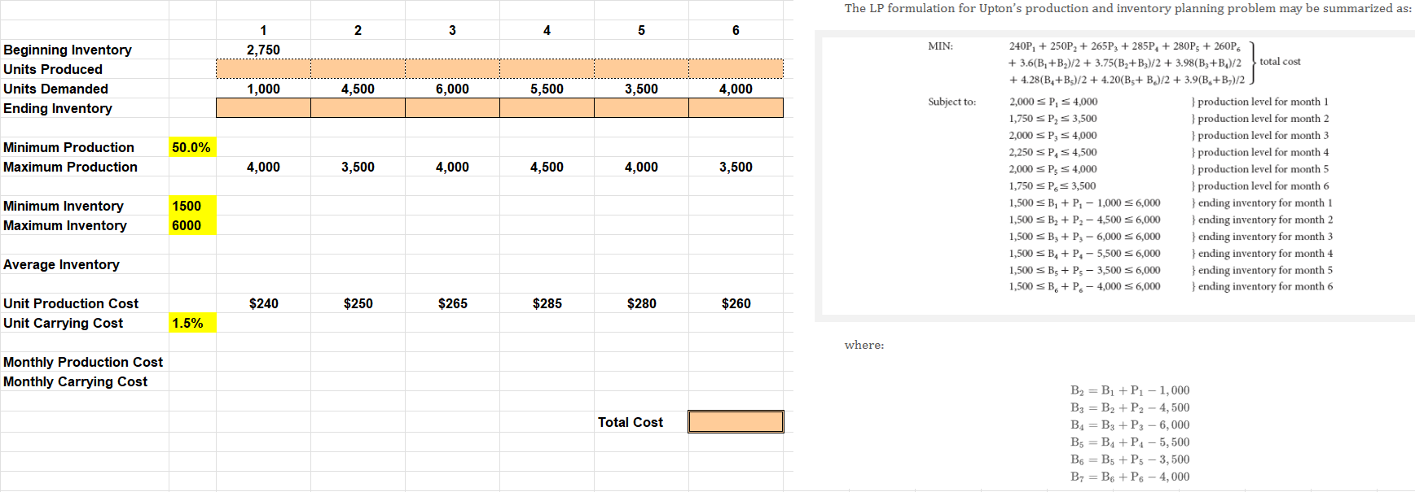
Create your model

